Slide 1
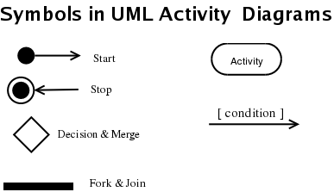
Basic Symbols

Slide 2
Activity Diagram for complaint logging for product .

Slide 3
